Slide 1
Strategy Pattern
Presented by
Fahim Ahmed
CSCI 370 46 [28015]

Slide 2
Strategy Pattern – What is it?
Type
Behavioral Pattern
Objective
To change class behavior or algorithm at runtime.
Approach
Objects are created using different strategies. A context object is basically created whose behavior can be changed as per its concrete strategy object. The concrete object decides behavior of the context object.

Slide 3
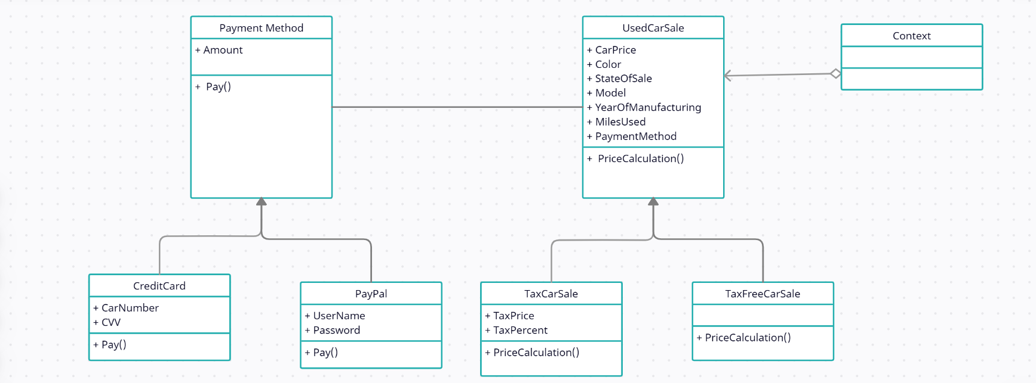
UML Class Diagram
: double
: double
: string
: void
: string
: string
: int
: string
: paymentMethod
: void
: string
: string
: double
: int
: string
: double
Concrete Classes
Credit Card and Paypal for Payment Method
: void
: void
: void
Concrete Classes
Tax Car Sale and Tax-Free Car Sale for Used Car Sale
: void

Slide 4
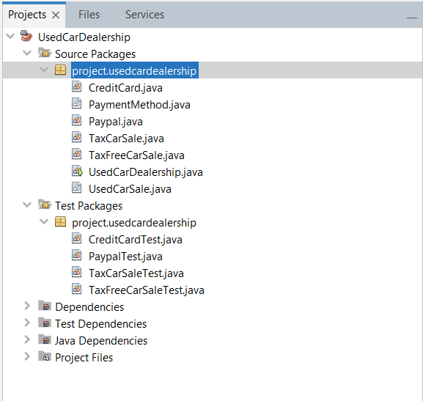
Code Structure

Slide 5
Code - Sale
public abstract class UsedCarSale {
public double CarPrice = 0;
public String Color = "Red";
public int YearOfManufacturing = 2020;
public String Model ="AB231";
public String StateOfSale ="Ohio";
public PaymentMethod PaymentType;
public abstract void PriceCalculation();
}
public class TaxCarSale extends UsedCarSale{
public double TaxPercent;
public double TaxPrice;
@Override
public void PriceCalculation() {
if(TaxPercent == 0)
{
System.out.println("Tax cannot be zero percent. Go For Tax Free Sales"); return;
}
TaxPrice = CarPrice*TaxPercent/100;
CarPrice = TaxPrice+CarPrice;
System.out.println("Price To Be Paid With Tax: "+ CarPrice);
}
}
public class TaxFreeCarSale extends UsedCarSale{
@Override
public void PriceCalculation() {
System.out.println("Price To Be Paid for Tax Free Car Sale: "+ CarPrice);
}
}

Slide 6
Code – Payment Methods
public abstract class PaymentMethod {
public double Amount=0;
public abstract void pay();
}
public class Paypal extends PaymentMethod {
public String UserName;
public String Password;
public void pay()
{
if(UserName.matches("^(.+)@(.+)$"))
System.out.println(Amount+" Paid by PayPal User: "+UserName);
else{
System.out.println("Username must be a valid email. Invalid Username: "+UserName);
}
}
}
public class CreditCard extends PaymentMethod{
public int CVV;
public String CardNumber;
public void pay()
{
if(CardNumber.length() == 16){
if(CVV <99 &&CVV>999){
System.out.println(Amount+" Paid by Credit Card Number: "+CardNumber);
}
else{
System.out.println("Invalid CVV "+ CVV);
}
}
else{
System.out.println("Invalid Card Number "+CardNumber);
}
}
}

Slide 7
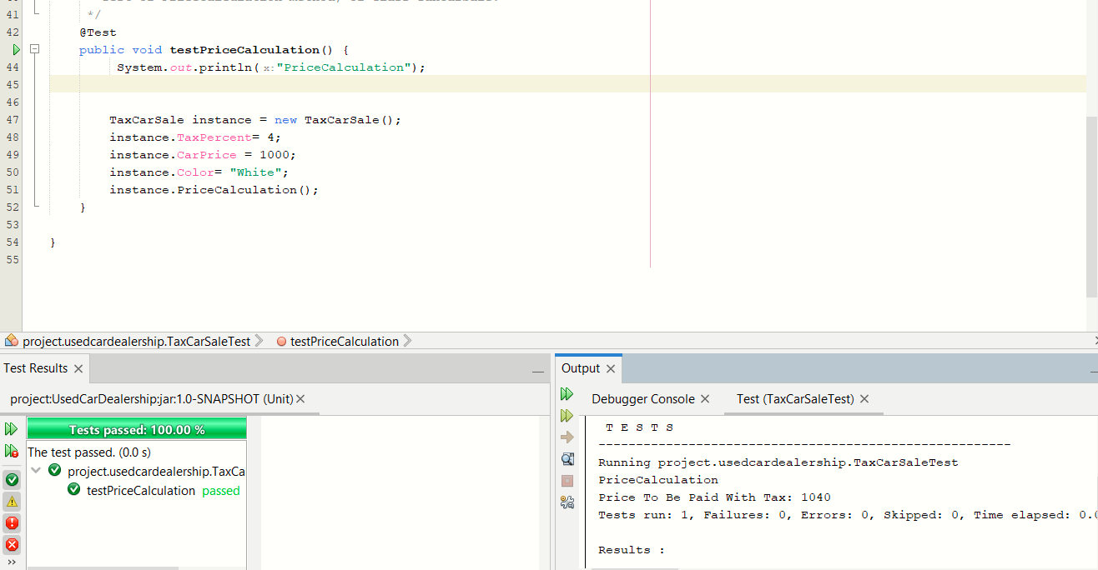
Unit Test 1 : Tax Car Sale Strategy

Slide 8
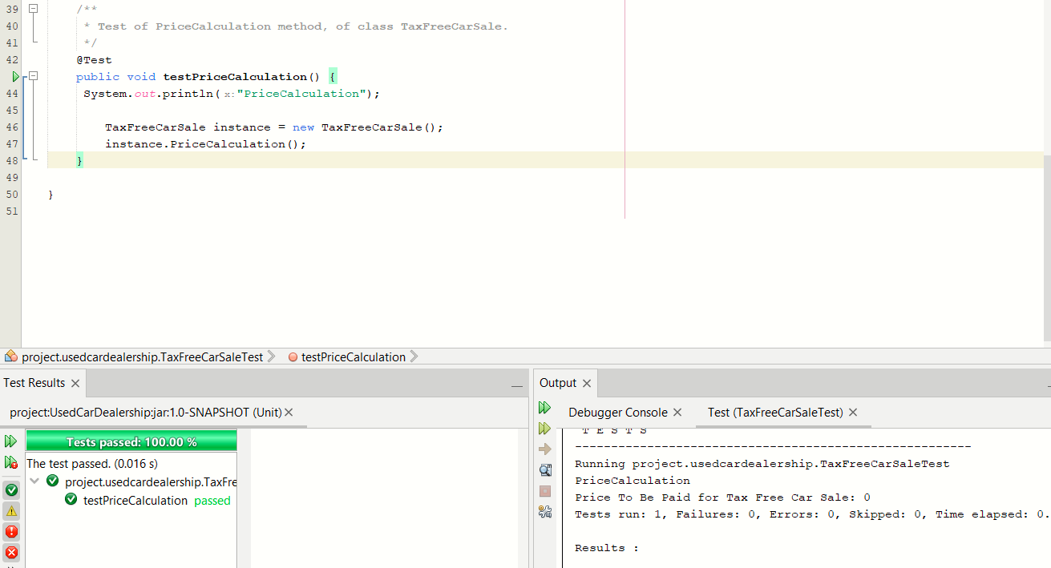
Unit Test 2 : Tax Free Car Sale Strategy

Slide 9
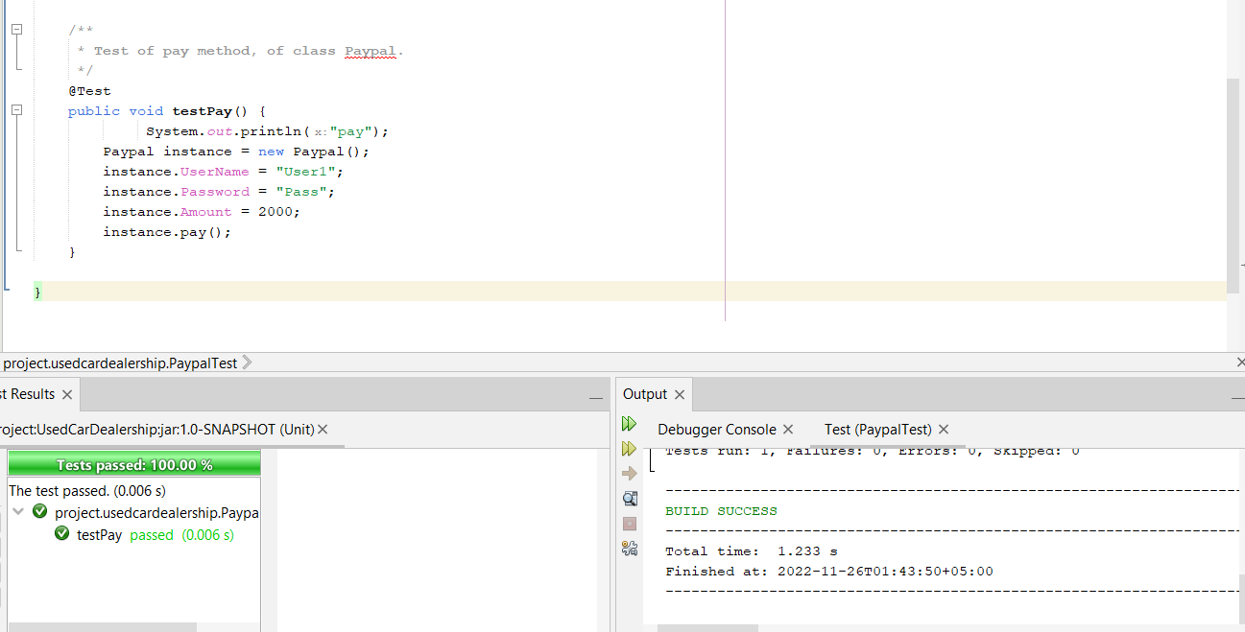
Unit Test 3 : Payment Method PayPal Strategy

Slide 10
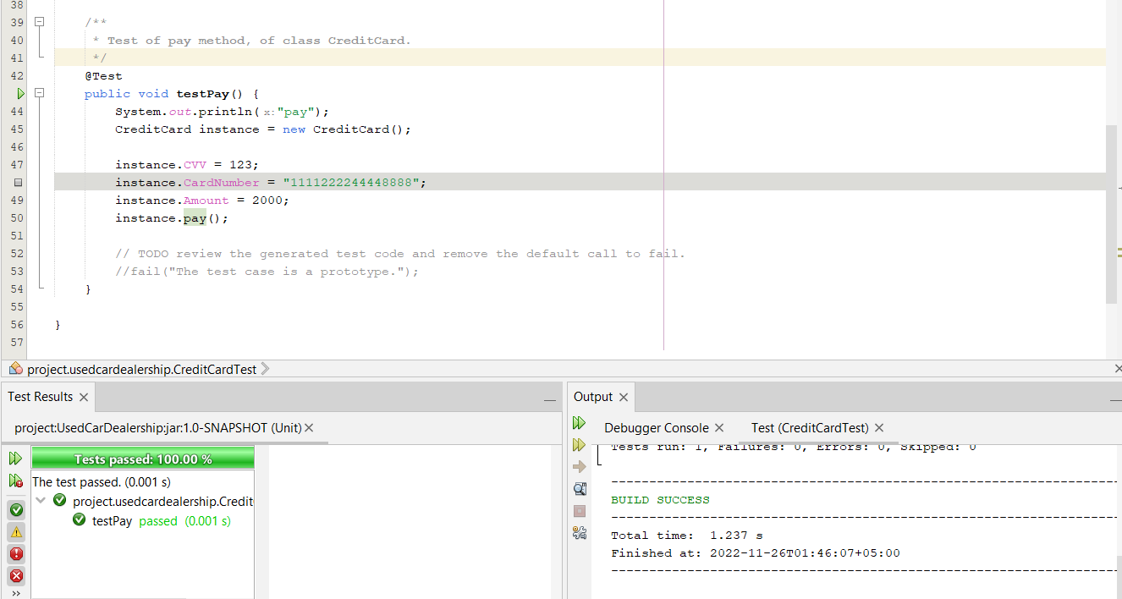
Unit Test 4 : Payment Method Credit Card Strategy

Slide 11
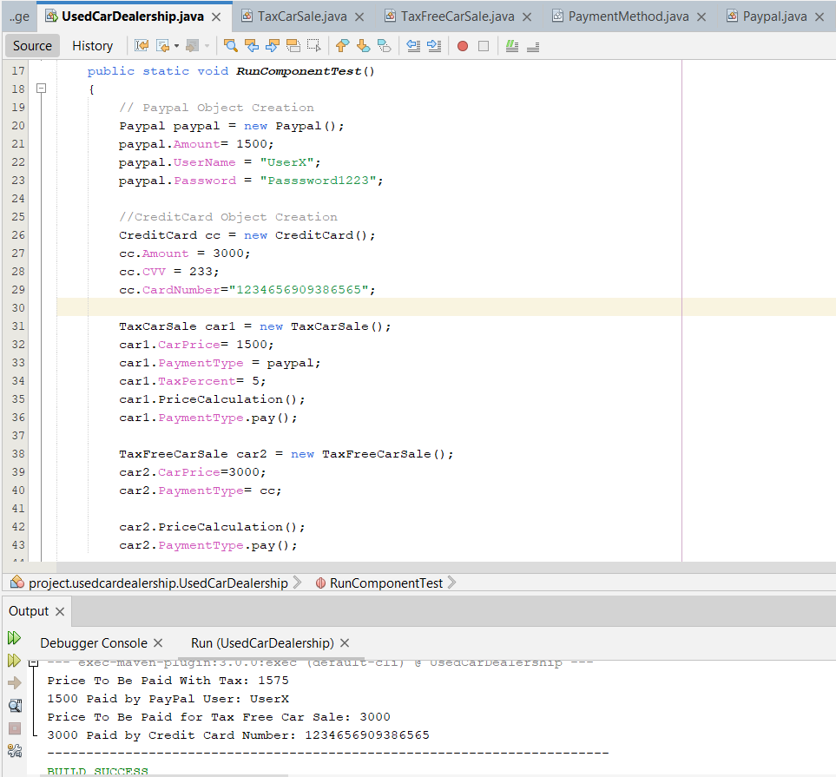
Component Test

Slide 12
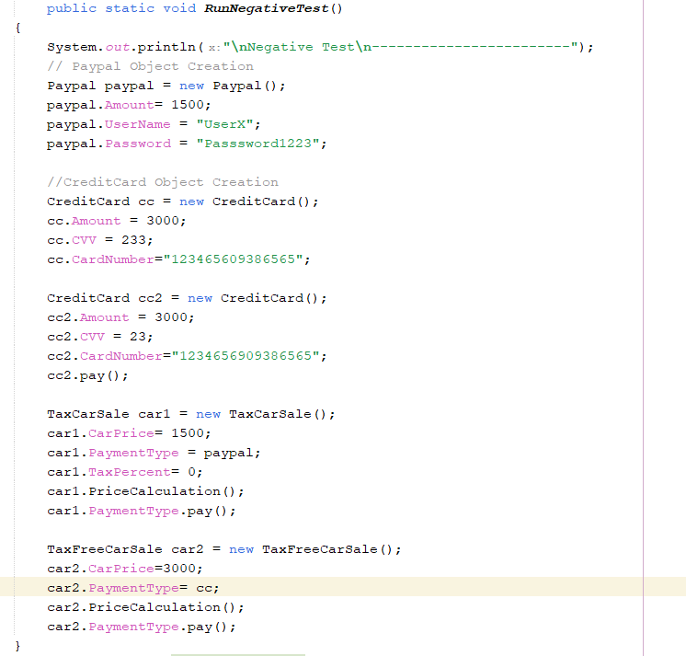
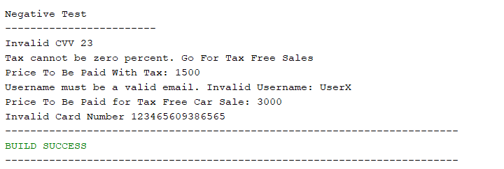
Negative Test
Output

Slide 13
Thank you

